Slide 1




See It
Learn It
Code It
Fulajtár József
Cisco Mo. Kft.
NWS2021
Notes:
Cisco DevNet is Cisco’s developer program: it’s the place for Cisco customers, partners, and individuals to go if they’re interested in writing applications, integrations or workflows that use Cisco platforms.
It’s the one stop shop for anyone wanting to learn about those platforms and find the resources they need: for example, sample code, documentation, ‘how to’ articles, and use cases.
DevNet has a very strong belief in hands-on learning, hence the motto of <click>
See It, Learn It, Code It.

Slide 2
DevNet Mission
Help Cisco’s employees, customers and partners grow in the modern economy and API economy
Make innovation easy. Help developers build solutions with Cisco platforms and APIs
Make DevNet developers successful in their businesses and careers
Notes:
DevNet’s 3-part Mission is quite simple:
<click>
To help Cisco’s employees, customers and partners grow in the modern economy and API economy
<click>
To make innovation easy. Help developers build solutions with Cisco platforms and APIs
<click>
To make DevNet developers successful in their businesses and careers
Before we go into what DevNet offers, let’s take a quick look at why there’s a need for DevNet.

Slide 3
Customers are asking us to …
Help them automate their infrastructure
Help them connect and integrate their systems
Programmability and APIs are the engine that enable
customers transform their business
Notes:
Well … customers have been asking us to:
Help them automate their infrastructure
Help them connect and integrate their systems
And it’s clear that we can do this through programmability and APIs.
<click>
“Programmability and APIs are the engine that enable
customers transform their business”
So how can we at Cisco help?

Slide 4

The New Network
Intent-based
Networking
APIs, DevOps
Automation
IoT,
Edge Computing
Cognitive Collaboration
Multi-Domain
Networking
Wi-Fi 6
and 5G
AI/ML
Secure
Networking
Notes:
To start with, we have the amazing Cisco product portfolio, covering everything from Intent Based Networking, to Cognitive Collaboration to Secure Networking.
This new network is a large part of how we can help.

Slide 5

Deliver New Experiences
Customers
Workers
Mobile Devices
Equipment
Users
Applications
Stores
Branches
Applications
Business Data
Customers
Integrate with workflows
Integrate with
3rd party apps
Build custom dashboards
Partners
Developer APIs
DevNet
1
1
1
1
Collaboration
IoT
SD-Access
SD-WAN
SD-Data Center
Infrastructure
Notes:
At the base layer we have our infrastructure: the infrastructure Cisco provides across all our areas. These all now – across the entire portfolio – and they expose APIs which means you can start building solutions and integrations and workflows on top of them.
<click>
As we saw just now, customers are asking for new experiences: they want to have easy access to everything that the users want. They want to build customised experiences using mobile devices and they want access to the data.
<click>
This is where partners and DevNet come together to really use the APIs to start to answer the questions of ‘how do we build some of these user experiences?’ How can we integrate workflows, integrate with other applications, produce custom dashboards?
And this is what the APIs are enabling, what the DevNet resources are enabling and what the DevNet Community (in particular partners) help people accomplish through their IT teams.
So, how can people get their hands on the APIs? <click>

Slide 6
DevNet Dev Centers
Notes:
Through the … DevNet Dev Centers.

Slide 7

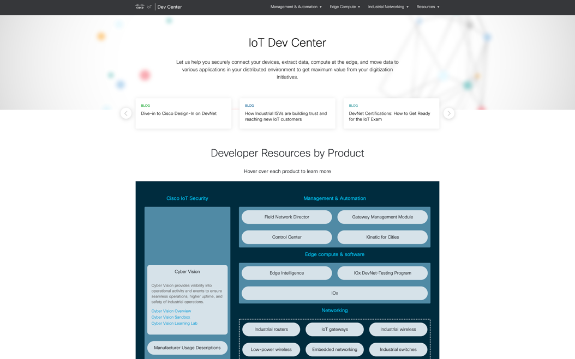
DevNet IoT Developer Center developer.cisco.com/iot
Select IoT Dev Resources
Central location for Cisco IoT Developers
Leverage IoT Developer Tools
Notes:
On the DevNet site we have what we call ‘developer centers’ (or Dev Centers) and we have a DevCenter for every major Cisco technology.
The one on the screen is the IoT Dev Center. It’s a typical example of a DevNet Dev Center, and comes complete with API documentation, sample code use cases, sandboxes, learning labs and tutorials.

Slide 8
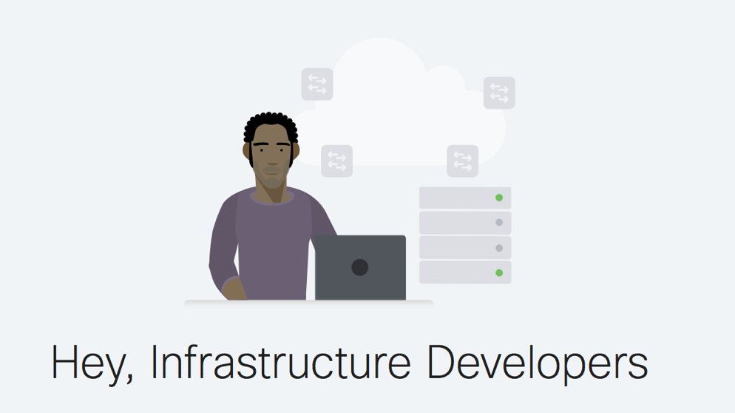






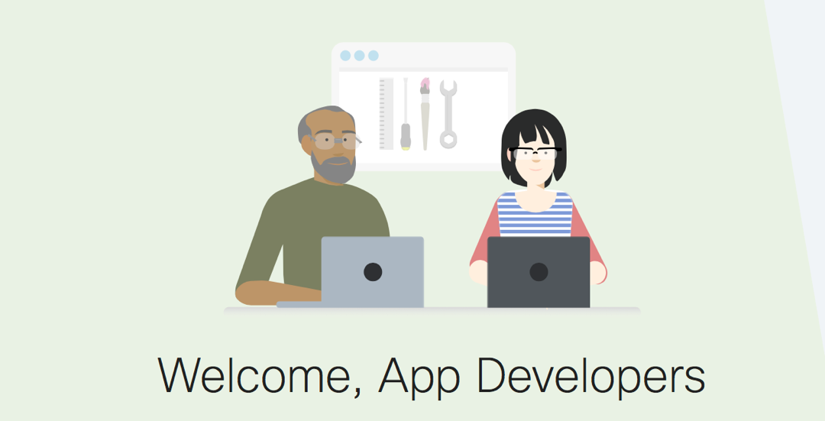


Cisco platforms
IoT
Networking
Collaboration
Services
Data Center
Cloud
Open Source
Security
Mobility
Notes:
And here’s the list of all the platforms that have a DevNet Dev Center.
<click>
And you see on the right side that the DevNet program caters for 2 different kinds of developers. The goal is to bring them together and help them work together,
And provide resources they both need.
INFRASTRUCTURE DEVELOPER
First of all we have Infrastructure developers. They’re from the ops side and are concerned with creating devops workflows, integrating tools on the backend, and automating networks. And they’re writing a lot of code to do those integrations.
They really care about automation, observability and security … they want to build apps and solutions that scale, with consistency and repeatability
APP DEVELOPER
And then we have the App Developer who’s typically been working in software for many years, and has a strong tendency towards Collaboration or IoT or mobile.
The APP DEVELOPERS are looking at cloud and multi cloud. App performance is of course key, together with security.
They both have different needs, and they’ll both find what they need on DevNet.
So what resources do we provide – to complement the API information within the DevCenters – to enable these developers to produce their solutions and applications using the APIs?

Slide 9
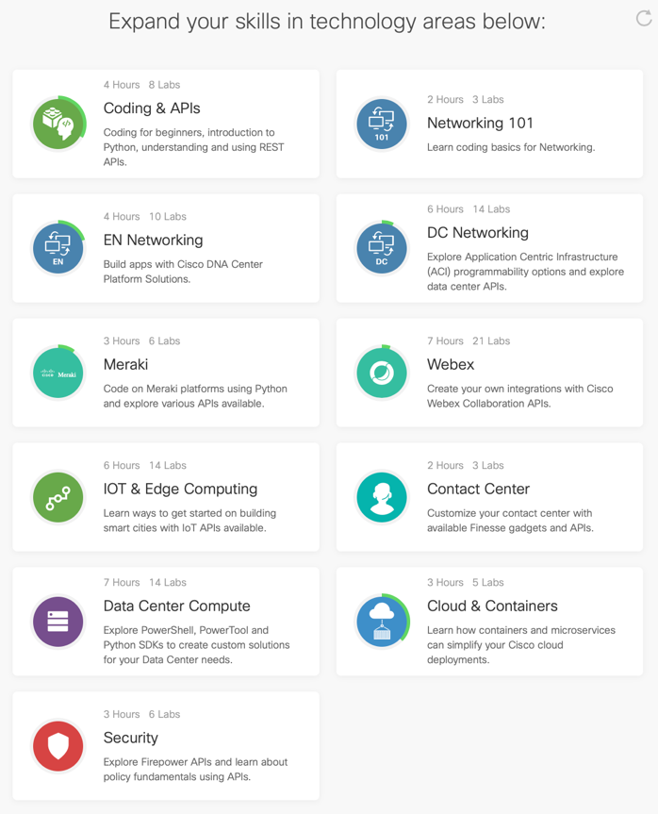
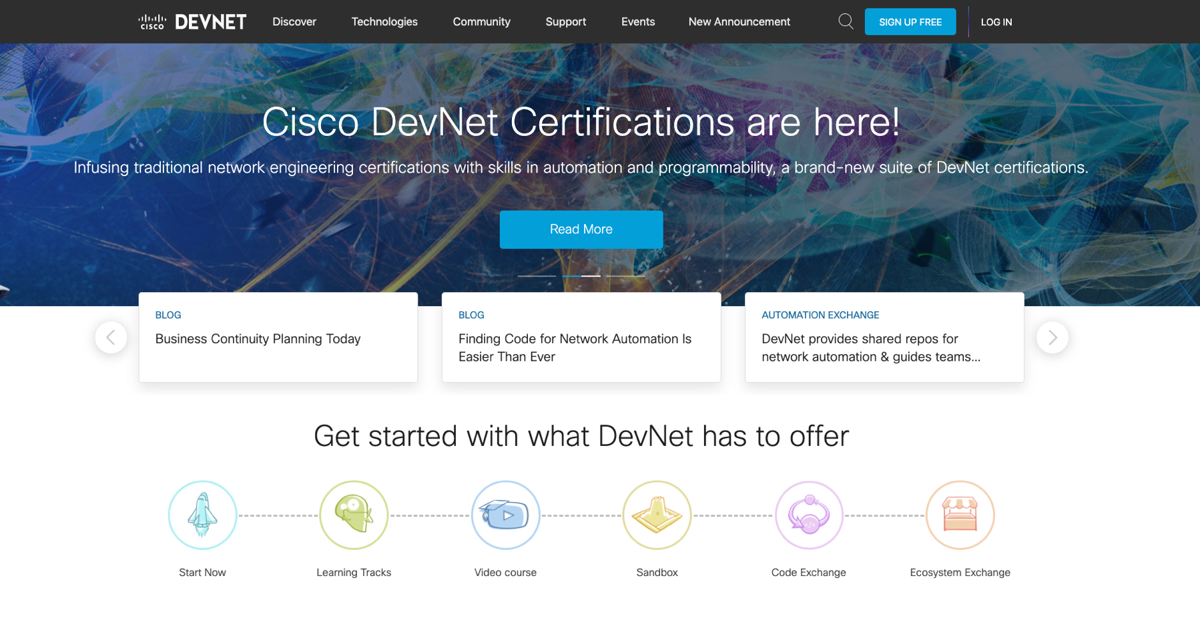
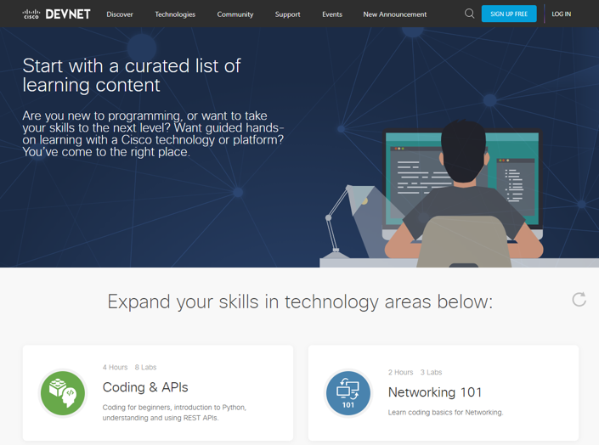
DevNet tools and resources developer.cisco.com
Notes:
START NOW
DevNet created this space because a lot of people said ‘this sounds great’ but where do I start?
As the name suggests, it’s the first port of call for people who want to start learning about Cisco platforms and taking some steps towards network automation.
Within Start Now you’ll find curated lists of Learning Labs, broken into bite-sized pieces. You can go from here and then dive in deeper with the Sandbox and certifications.

Slide 10
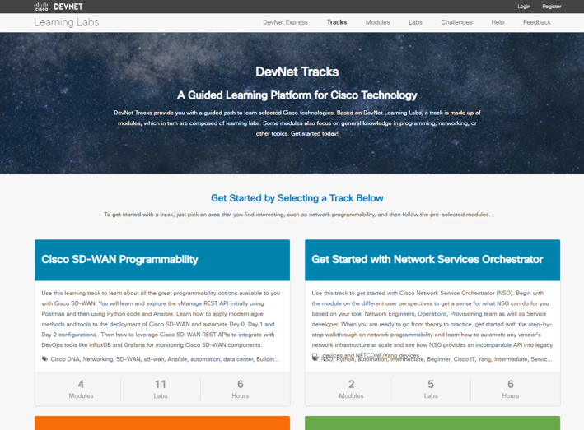
DevNet tools and resources developer.cisco.com
Notes:
Secondly, there’s full list of Learning Tracks covering all Cisco technologies: the tracks are online and self-paced, with each track comprising modules labs.

Slide 11
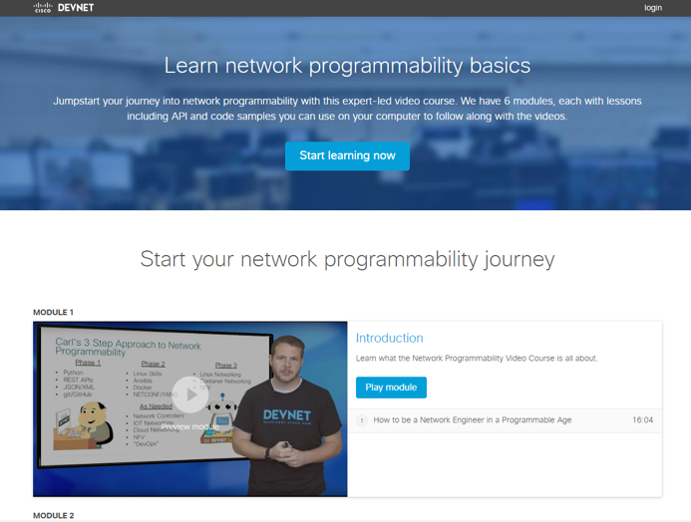
DevNet tools and resources developer.cisco.com
Notes:
Then you can dive into our online VIDEO COURSES

Slide 12
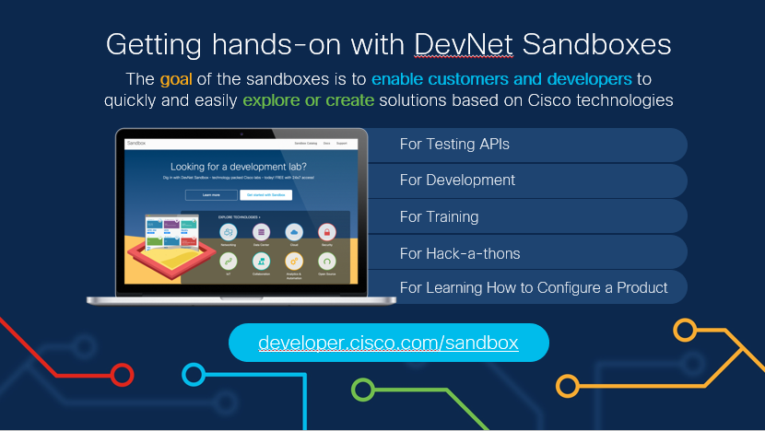
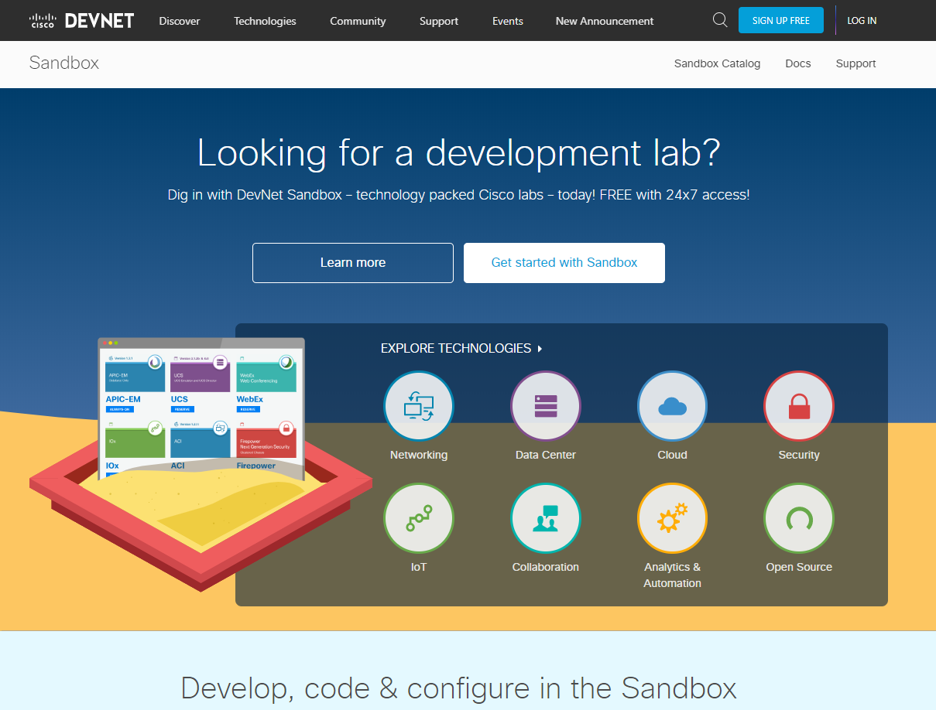
DevNet tools and resources developer.cisco.com
Notes:
And there’s the SANDBOX where you can get hands-on with pretty much any Cisco platform. If, for example, you’re working against DNA Center, you don’t have to have your own DNA Center lab to start developing … you can reserve one in the Sandbox, and start sharing it within your team.
<click>
Within the Sandbox there are hardware-based environments, virtual environments and pure development environments, covering labs across all areas. It’s definitely a huge resource with DevNet.

Slide 13
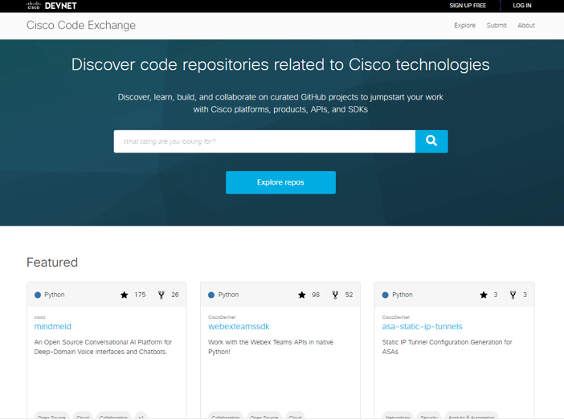
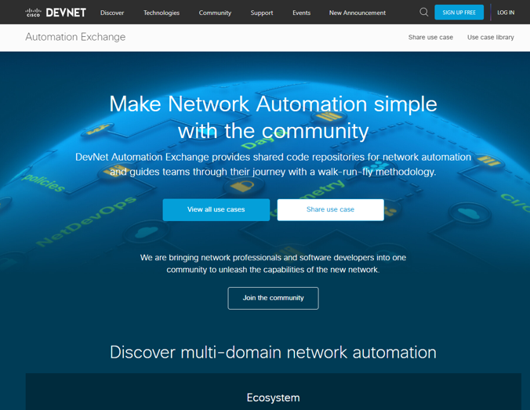
DevNet tools and resources developer.cisco.com
Notes:
CODE EXCHANGE and AUTOMATION EXCHANGE
Code Exchange is an online, open source, curated set of code repositories (solutions) related to Cisco technology areas. The actual code is found in associated GitHub orgs. Code Exchange is really a place in which the community can share code they’ve been working on. You can upload code, or you can search for results: for example, you might be looking for code that works against DNA Center, written in Python that will help you manage a list of network devices.
<click>
Automation Exchange is an online, open source curated set of Use Cases broken down using the ‘walk-run-fly’ methodology, together with the steps on how to accomplish the Use Case. Each Automation Exchange Use Case uses one of the published Code Exchange code repositories.

Slide 14
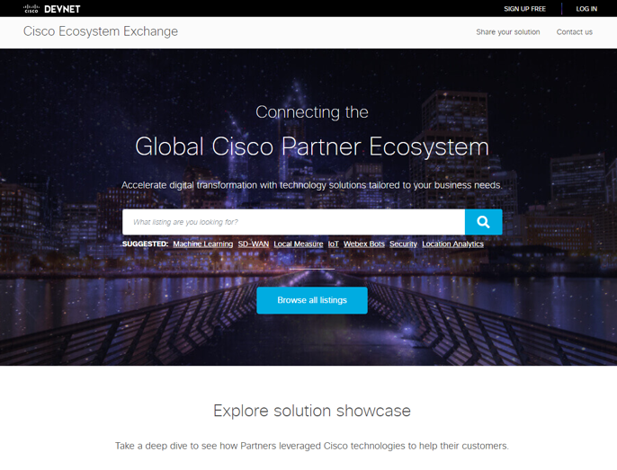
DevNet tools and resources developer.cisco.com
Notes:
And then there’s Ecosystem Exchange … which is a growing catalog of over 1500 business solutions created by the Cisco ecosystem covering all of Cisco’s technology platforms. It’s a place where partners can amplify and market their built solutions to Cisco sellers and buyers. For Cisco customers, it is a place to discover and consume packaged solutions that drive real business outcomes.
It includes Solutions Plus Partners, Solutions Partner program partners and their associated solutions.
It’s also the place in which DevNet Specialized partners are showcased. More about that later.
So having looked at the website in brief, we’ll now take a look at all the resources DevNet has to offer …

Slide 15
Community
Partner Transformation
Learning
DevNet Community
CCIEs and software developers share learnings and best practices
DevNet Specialization
Recognizing partners with demonstrated software capabilities
and business practices
DevNet Express Workshops
Hands-on workshops to teach software skills, automation, and Cisco APIs
Code Exchange
Shared code and 3rd party apps for network automation use cases
Learning Labs
Learn at your own pace
Sandbox
Run code against live infrastructure and access technology packed Cisco labs
Automation Exchange
Software practices in networking
Ecosystem Exchange
Explore 3rd party solutions
DevNet Certifications
Build software skills for your future
Solutions Plus
Select Cisco Compatible products on the global price list
DevCenters
Get the latest API docs, labs, sample code, and tutorials
Notes:
We have the COMMUNITY resources on the left side, LEARNING AND TRAINING on the right, and PARTNER TRANSFORMATION in the middle.
Starting with COMMUNITY … we have the DevNet Community: a 500,000 strong DevNet membership sharing learnings and best practices.
Code, Exchange, Automation Exchange and Ecosystem Exchange which I’ve already mentioned.
And we have Solutions Plus partners, who are partners who have Cisco Compatible products that are listed in the Cisco global price list. They’re included within Ecosystem Exchange.
Looking over to the LEARNING section, there are a number of ways in which DevNet members can learn: either self-paced or instructor-led … in-person or virtually: you could attend a DevNet Express event or workshop, run by Cisco all over the world covering Cloud Collaboration, DNA, Security, DCI or Meraki technologies. And we’ve already covered the LEARNING LABS and the SANDBOX. <click>

Slide 16

Principles of Intent-Based Networking
Cisco DNA Center
Applications
Automation, built-in security, streaming telemetry, rich analytics, programmability
APIs
Domain Controllers
Powered by IOS-XE
Modular, scalable, highly available OS
Physical and Virtual
Infrastructure
ASIC
Custom ASICs, Virtualization
Notes:
To re-invent the network, we are architecting with a set of key design principles to get us there
Custom ASICs that allow us to future proof for an ever change world like IoT or move beyond the standard
De-couple software from hardware, with physical and virtual infrastructure to maximum deployment flexibility
Deliver a modernized modular OS that supports IT simplicity and robust security built in
Controllers for key domains to translate business goals into policy, activate end-to-end through automation, and provide assurance through rich contextual visibility and streaming telemetry
Open & Programmable, with standards base API that make it seamless to bridge IT processes

Slide 17


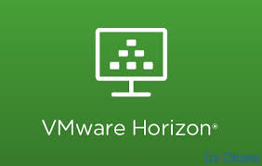

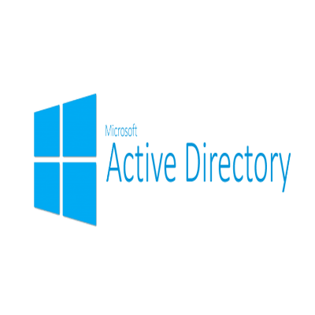


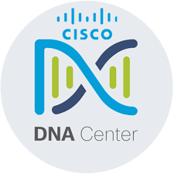
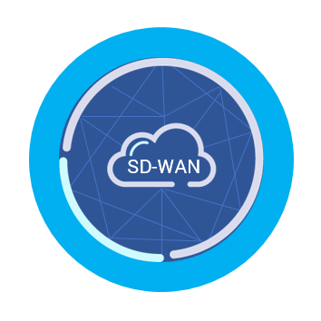










SDN architecture
Applications
Controller
APICenter v4
Infrastructure

Slide 18
The IT Team of the Future
Infrastructure
Skills and Expertise
Software
Skills and Expertise
We can build this together.
Notes:
DevNet has a very strong belief that the successful IT Teams of the future are going to be the ones that really have a strong combination of infrastructure skills and software skills.
Those skills may be found in one person, or they may be found within a team. We want to help build the necessary skills, in your individuals, and also in your teams.
<click>

Slide 19
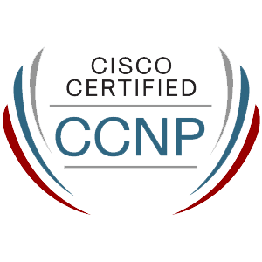
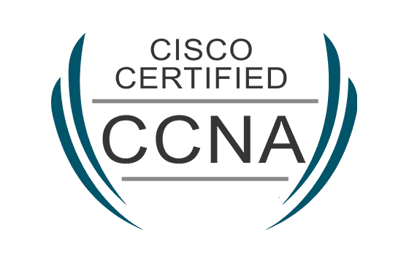
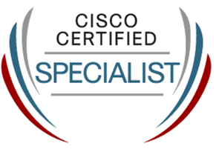
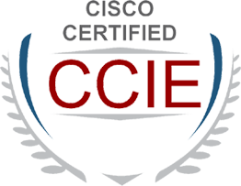
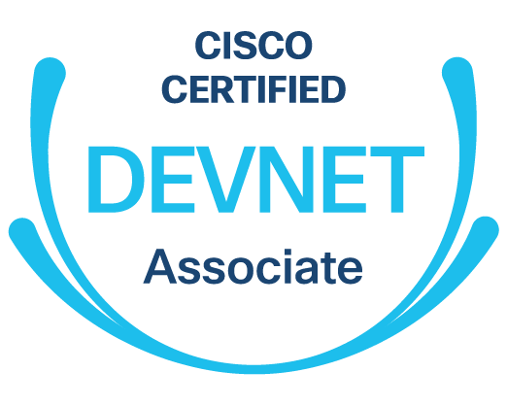
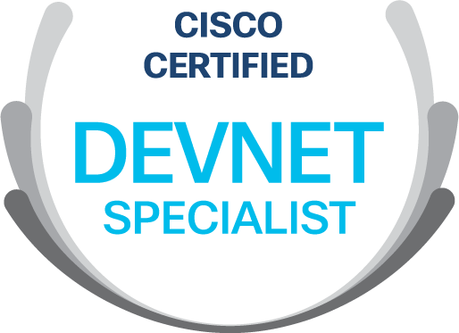
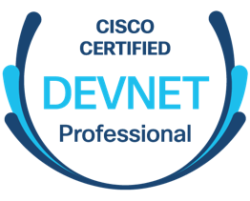
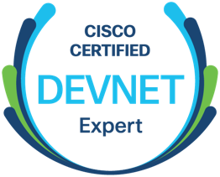
What are DevNet Certifications?
Cisco Certifications
Associate Level
Specialist Level
Professional Level
Expert Level
Engineering
Track
Future
Offering
Software
Track
Notes:
What are DevNet Certifications?
Cisco has had Network Engineering certification levels: CCNA, Specialist, CCNP and CCIE for many years: they’re qualifications that are respected around the world: it’s a hugely successful program.
Well. we’ve introduced a new track called the DevNet Certification track or the Software track. It aligns to the same levels as the Network Engineering track … both tracks have the same kinds of exams, the same rigour, the same levels of expertise, but the DevNet Certifications focus more on software skills. The goals is to enable people to build those skills, connect, and build those combined teams.

Slide 20
Cisco DevNet Certifications
Building skills for Automation and Digital Transformation developer.cisco.com/certification
Notes:
Within the Software Track, <click> at the first level there’s DevNet Associate which comprises one exam, and is a great place to get started. It proves that the individual has skills in developing and maintaining applications built on Cisco platforms. To earn DevNet Associate certification, the person must pass one exam.
<click>
The specialist certification requires passing one exam and provides the opportunity for individuals to take advantage of new opportunities in application design and/or software development. They can skill up on driving automation within our technologies or create applications on top of the core technologies, webex, DevOps, or IOT.
<click>
The Professional certification is more comprehensive. There are two exams; one that covers core software development and design for Cisco platforms, and one software developer concentration exam depending on the individuals focus area.
The program has been designed so that these certifications can combine together to help people prepare for new job roles that we’re seeing.

Slide 21
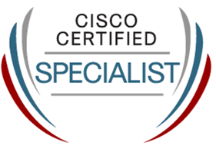
DevSecOps Engineer
Training for new job roles
Professional certification
Technology concentrations
Cisco Specialist: Security
Automate security operations
Cisco DevNet Specialist: DevOps
Securely deploy applications
CCNP Security
Cisco DevNet Specialist: Webex
Build chat bots for alerting and monitoring
Notes:
Another role is a DevSecOps Engineer.
This is a huge area with tons of growth: people are looking for people with this combination of security and DevOps.

Slide 22
The 61 Cisco training courses supporting the new certifications
Architecture | Course
Cloud / Automation | Deploying Cloud Connect Solutions with Cisco Cloud Services Router 1000V
Collaboration | Implementing and Operating Cisco Collaboration Core Technologies
Collaboration | Understanding Cisco Collaboration Foundations
Collaboration | Implementing Cisco Advanced Call Control and Mobility Services
Collaboration | Implementing Cisco Collaboration Cloud and Edge Solutions
Collaboration | Implementing Cisco Collaboration Applications
Data Center | Implementing Cisco Application Centric Infrastructure – Advanced
Data Center / Compute | Implementing Cisco Application Centric Infrastructure
Data Center / Compute | Understanding Cisco Data Center Foundations
Data Center / Compute | Configuring Cisco NX-OS Switches and Fabrics in the Data Center
Data Center / Compute | Introducing Cisco NX-OS Switches and Fabrics in the Data Center
Data Center / Compute | Implementing and Operating Cisco Data Center Core Technologies
Data Center / Compute | Configuring Cisco MDS 9000 Series Switches
Data Center / Compute | Designing Cisco Data Center Infrastructure
Data Center / Compute | Configuring Cisco Nexus 9000 Series Switches in ACI Mode
Data Center / Compute | Implementing Cisco HyperFlex
Data Center / Compute | Configuring Cisco MDS 9000 Series Switches
Data Center / Compute | Introducing Cisco Nexus 9000 Switches in NX-OS Mode
Data Center / Compute | Cisco Application Centric Infrastructure Operations and Troubleshooting
Data Center / Compute | Configuring Cisco Unified Computing System
Data Center / Compute | Troubleshooting Cisco Data Center Infrastructure
Data Center / Compute | Introducing Cisco Unified Computing System
Data Center / Compute | Managing LAN Infrastructure with Cisco Data Center Network Manager
Data Center / Compute | Managing LAN and SAN Infrastructure with Cisco Data Center Network Manager
Enterprise | Implementing Cisco Enterprise Advanced Routing and Services
Enterprise | Understanding Cisco Wireless Foundations
Enterprise | Designing Cisco Enterprise Networks
Enterprise | Implementing and Administering Cisco Solutions
Enterprise | Designing Cisco Enterprise Wireless Networks
Enterprise | Engineering Cisco Meraki Solutions Part 1
Enterprise | Implementing Cisco SD-WAN Solutions
Enterprise | Implementing and Operating Cisco Enterprise Network Core Technologies
Enterprise | Implementing Cisco Enterprise Wireless Networks
Network Management (NMS) | Operating Cisco EPN Manager
Security | Securing Networks with Cisco Firepower Next Generation Firewall
Security | Securing the Web with Cisco Web Security Appliance
Security | Securing the Web with Cisco Web Security Appliance
Security | Securing Networks with Cisco Firepower Next Generation Firewall
Security | Securing Networks with Cisco Firepower Next-Generation Intrusion Prevention System
Security | Implementing and Configuring Cisco Identity Services Engine
Security | Securing Email with Cisco Email Security Appliance
Security | Implementing and Operating Cisco Security Core Technologies
Security | Implementing Secure Solutions with Virtual Private Networks v1.0
Service Provider | Cisco Optical Technology Advanced
Service Provider | Implementing and Operating Cisco Service Provider Network Core Technologies
Service Provider | Understanding Cisco Service Provider Network Foundations
Service Provider | Implementing Cisco Service Provider Advanced Routing Solutions
Service Provider | Implementing Cisco Service Provider VPN Services
DevNet | DevNet Associate Fundamentals Training from DevNet
DevNet | Developing Applications and Automating Workflows using Cisco Platforms
DevNet | Introducing Automation for Cisco Solutions
DevNet | Developing Applications Using Cisco Core Platforms and APIs
DevNet | Developing Solutions using Cisco IoT & Edge Platforms
DevNet | Implementing DevOps Solutions and Practices using Cisco Platforms
DevNet | Developing Applications for Cisco Webex and Webex Devices
DevNet - Collaboration | Implementing Automation for Cisco Collaboration Solutions
DevNet - Data Center | Implementing Automation for Cisco Data Center Solutions
DevNet - Enterprise | Implementing Automation for Cisco Enterprise Solutions
DevNet - Security | Implementing Automation for Cisco Security Solutions
DevNet - Service Provider | Implementing Automation for Cisco Service Provider Solutions
Notes:
To help people get there, we’ve introduced 61 new Cisco training courses with more coming, through the Cisco Platinum Learning Library.

Slide 23
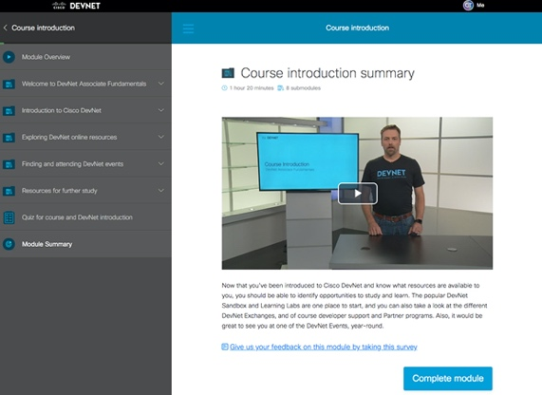
New DevNet tools to help you prepare
DevNet Associate Fundamentals Training
New DevNet Study Groups
Next generation learning experience
Interactive all-in-one coding environment
Built-in integrated labs
Online community platform
Study group leaders and participants
Curated content for Cisco technologies
and certifications
Join our beta program today
developer.cisco.com/certification
Notes:
And through DevNet we have a couple of new tools to help you train for the certifications.
The Fundamentals training is a new online, self-study experience that has an all-in-one coding environment with integrated labs, which means you can do the learning and be coding right in the browser console
People have had great success using it as a self-study tool to prepare for the Associate exam.
The Study Group gives you a way of leading or joining a group of like-minded people studying towards the certifications.
Through the Study Group platform you can set up events, give homework, have discussions, encourage each other to learn.
Or if you want more of a light-touch self-paced way of learning, you can always go to the self-paced learning labs that we recommend on DevNet for each certification.
Or, you can attend a DevNet Express or Workshop which will help prepare you for the Associate level.
One of the requirements for partners being awarded DevNet Specialization, is for a certain number of individuals within their organisation to have received a DevNet Certification at Professional or Specialist level.
So what is DevNet Specialization? <click>

Slide 24
Notes:
THANK YOU!

